Slide 1
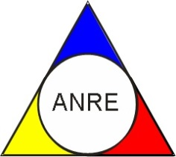
Consumers of Electric Vehicles
Roundtable Discussion
Hosted by:

Slide 2
Legislation/ Duties
Do you have legislation on Electric Vehicles
If yes, what are the regulatory duties regarding them

Slide 3
Electric charging points
Are these part of the distributed network or separated
What challenges and disadvantages of installing the new charging points for the network systems you are facing

