Slide 1
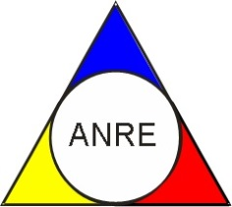
Vulnerable Customers
Roundtable Discussion
Hosted by:

Slide 2
How vulnerable customers detected
Provide guidance and share best practices on how to detect and reach vulnerable customers once the concept is identified.

Slide 3
Assistance for vulnerable consumers
Explore non-Financial support options ;
Delve into financial assistance mechanism (on energy bills) and discuss how the distributor will be compensated in such cases

Slide 4
Role of national regulatory authorities in supporting vulnerable consumers
Pivotal role that NRAs play in supporting vulnerable consumers and ensuring their needs are adequately addressed

